Slide 1
Logo animation (intro)

Slide 2



Title slide
Chrome Extension development
Customized empowerment
Lucas Jellema
Conclusion Code Café – June 2024

Slide 3
Chrome extension development
Why? use cases
What can be done? Types of interaction
context menu, side panel, document manipulation, notifications, manage downloads, bookmarks, keyboard shortcuts, observe and manipulate web requests
How?
create and load manifest.json (as unpackaged)
add resources: content for direct DOM manipulation, injected script for JavaScript interaction, iframe, background service worker, options for extension settings, popup for user interaction, side panel
Examples
Harvest Link Details in Side Panel
Add button, Highlight headings, replace numbers in News Site
Collect LinkedIn details
Manipulate buttons and links to automate tasks
Notes:
https://developer.chrome.com/docs/extensions/develop

Slide 4
Challenges
Add option to context menu
Expose settings to govern extension behavior (through custom settings page)
Persist data to local storage or to local file (and retrieve)
Exchange data between page and service worker
Trigger custom logic in page for dynamic (SPA) pages (observe mutation in element)
Interact with JavaScript in page (inject custom JavaScript in DOM)

Slide 5

Basics of an extension
manifest.json
[Icons]
background.js – service worker (no access to web page)
content.js – runs in context of web page, has read & write access to DOM – not to JavaScrip
but it can inject a SCRIPT element
popup (html & js)
sidepane (html & js)
options (html & js)
sandbox

Slide 6
My First extension
Add big fat button in every web page

Slide 7
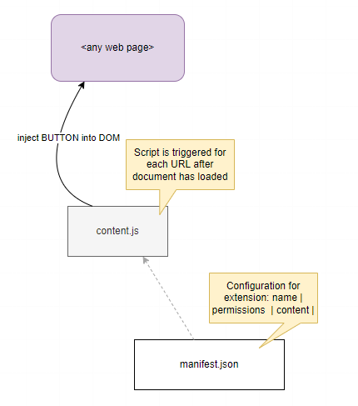
My First extension
Add big fat button in every web page
content.js to manipulate the DOM and add a button element
manifest.json to provide configuration for Chrome to understand the extension
and activate for every page

Slide 8
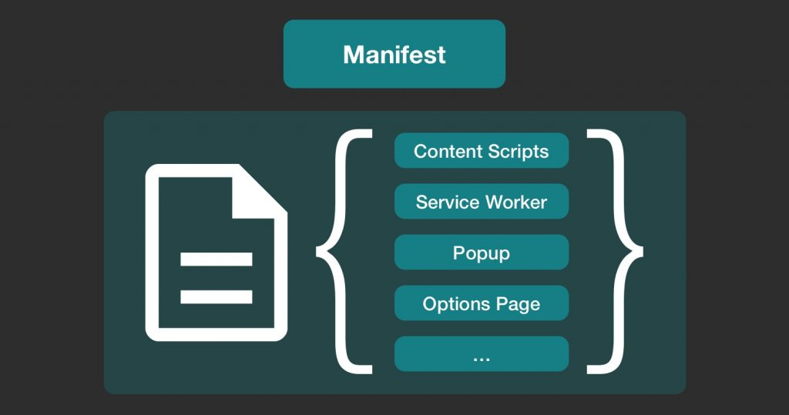
Manifest.JSON – configures the extension

Slide 9
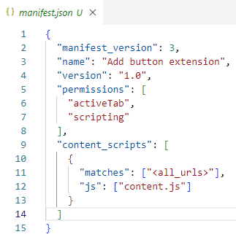
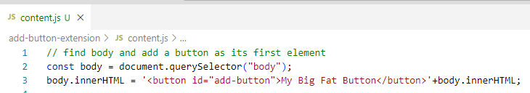
Manifest.JSON – configures the extension

Slide 10
Contents.js – runs for every page, manipulates the DOM of every page

Slide 11
Contents.js – runs for every page, manipulates the DOM of every page

Slide 12
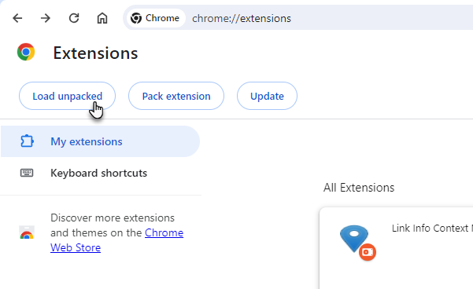
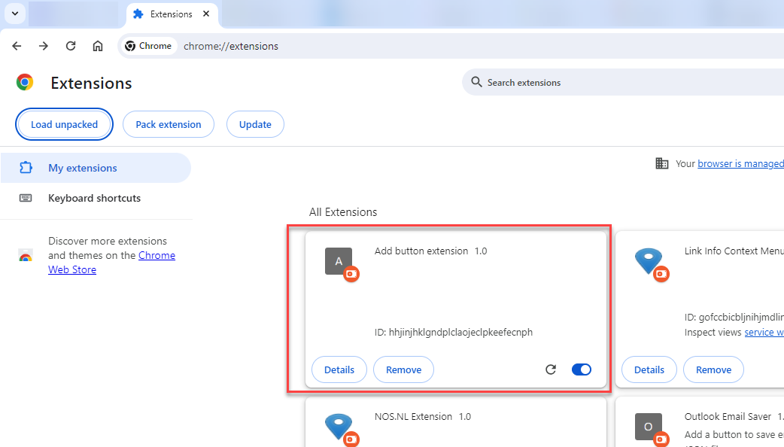
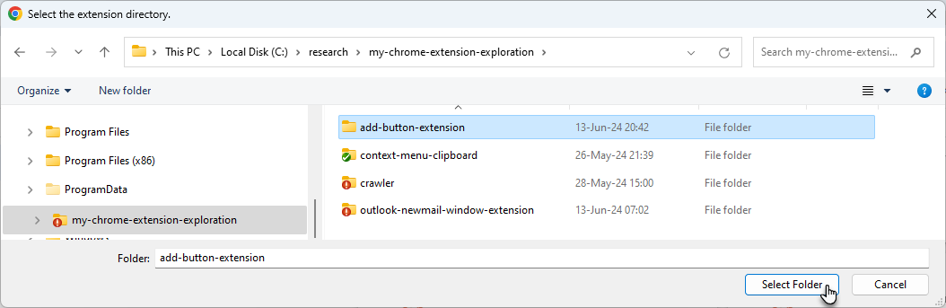

Slide 13
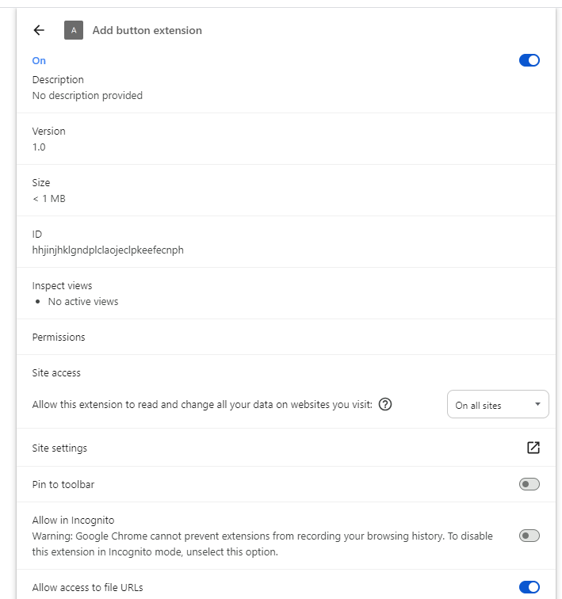

Slide 14
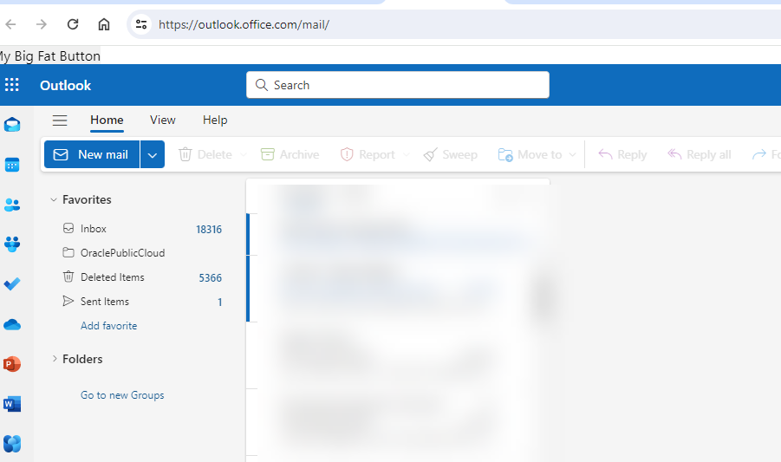
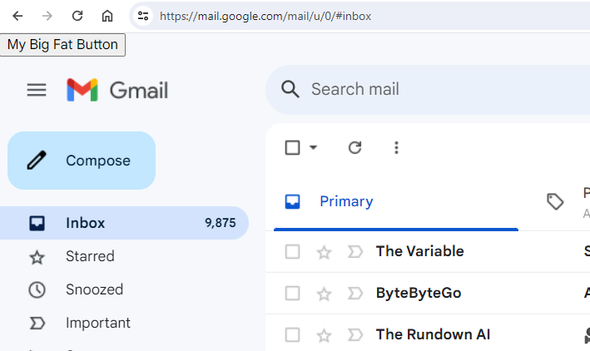
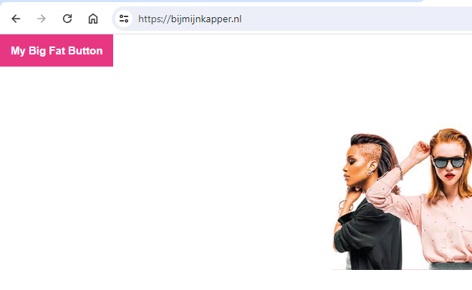
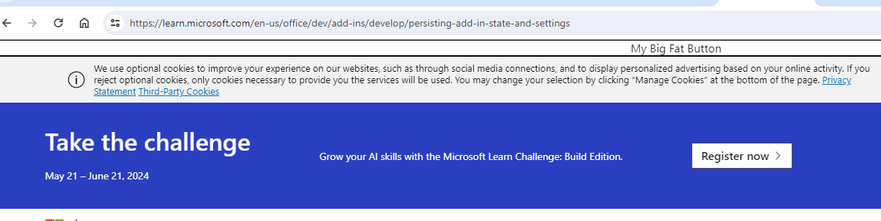
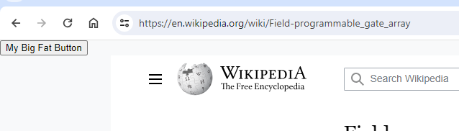

Slide 15
What else in an extension? Manifest.JSON – configures the extension
Side Panel

Slide 16
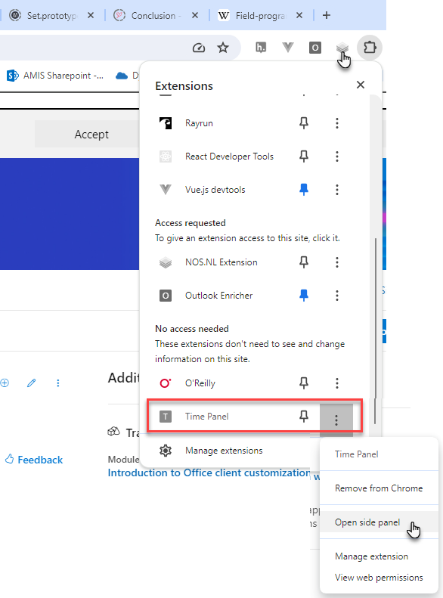
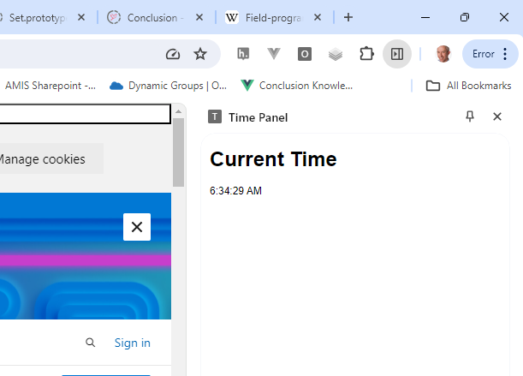
side panel to show the current time

Slide 17
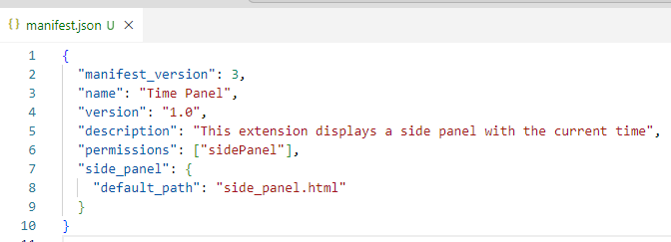
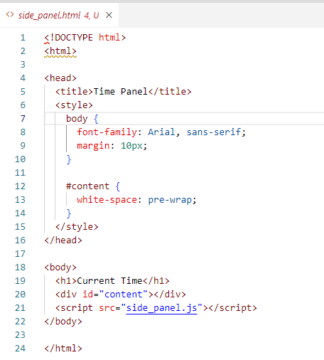
Time panel

Slide 18
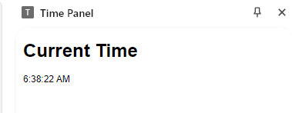
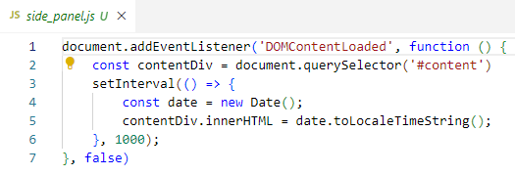
Time panel

Slide 19
What else in an extension? Manifest.JSON – configures the extension

Slide 20
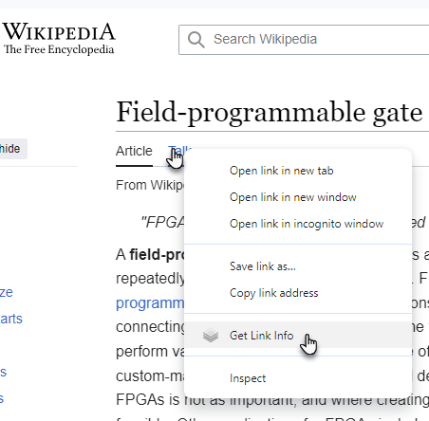
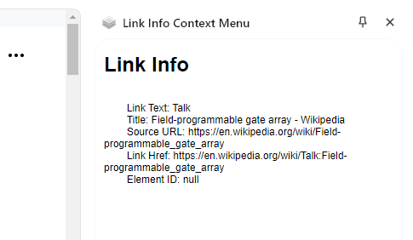
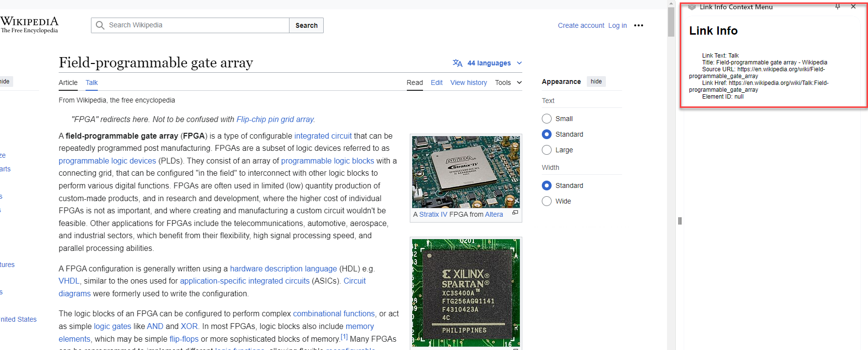
Get Link info
Add a custom option to the context menu
in this case for links (<a> elements)
When activated, open a side panel
and show details regarding the link

Slide 21
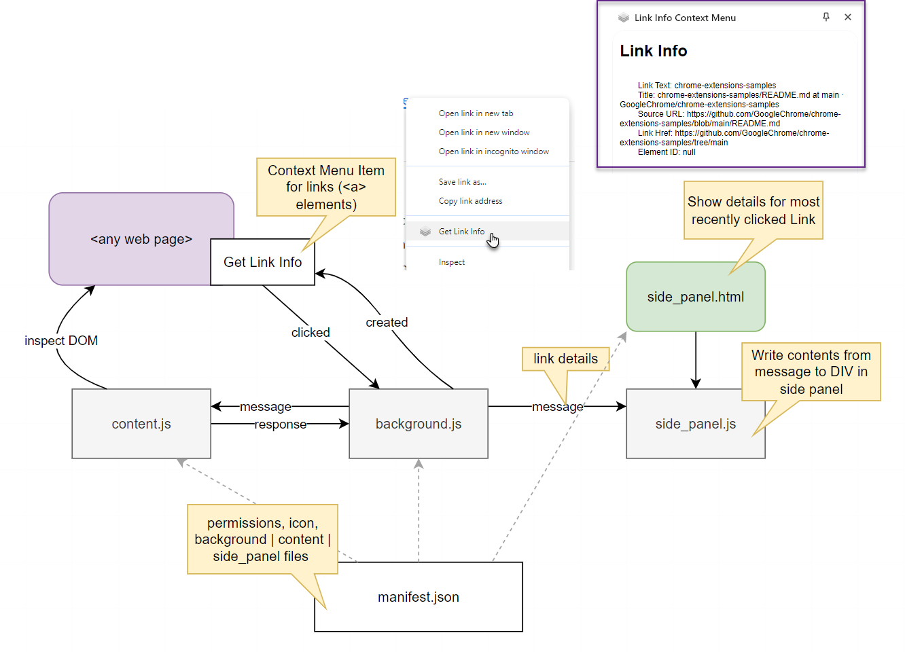
Link details
2
5
3
1
4
8
9
6
7

Slide 22
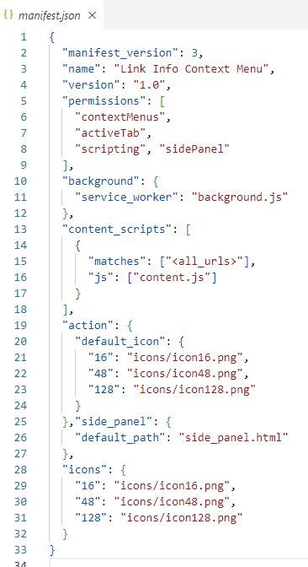
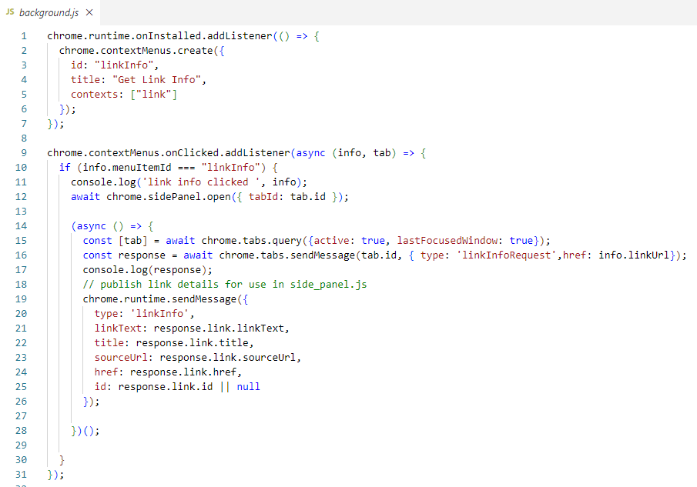
Implementation of the Link detail provider
1

Slide 23
Implementation of the Link detail provider
1
3
2
5
3
1
4

Slide 24
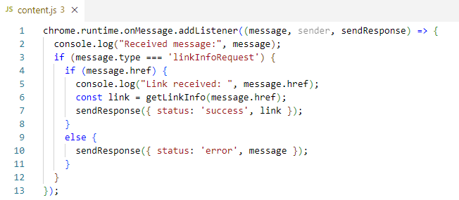
Implementation of the Link detail provIder
and other code snippets
1
3
7
4
6

Slide 25
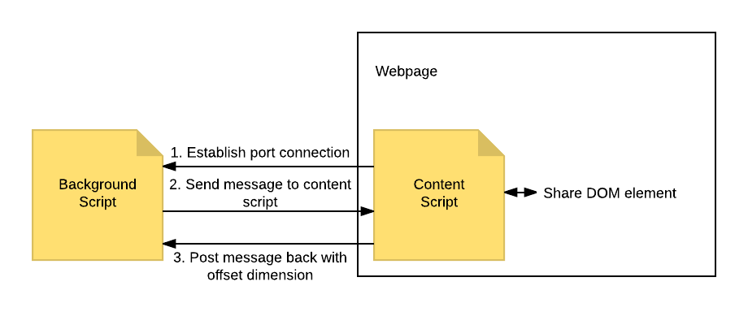
content script is injected in document
Content script can inspect and manipulate the DOM
It cannot read JavaScript variables or invoke JavaScript functions
However: it can inject SCRIPT elements that can do those things
Content script can exchange messages with background script (service worker)
Also:
Custom Events between content script and injected script
IFRAME messages between injected script and other IFRAMES
iframe
injected script

Slide 26
Implementation of the Link detail provIder
and other code snippets
1
3
7
4
6

Slide 27
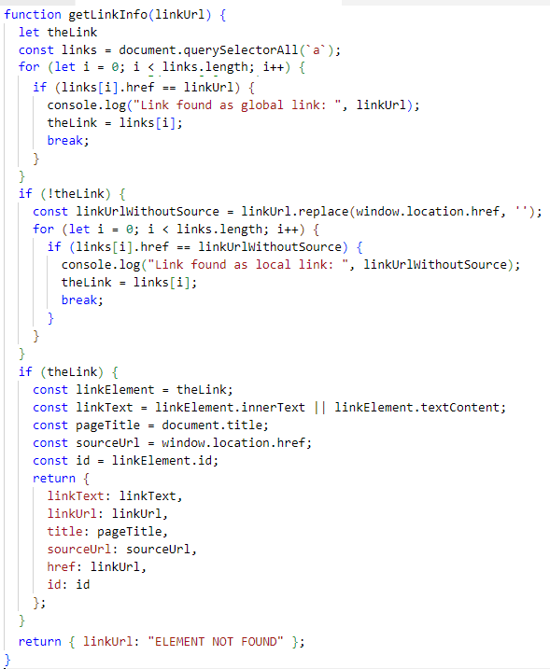
Implementation of the Link detail provIder
4
6

Slide 28
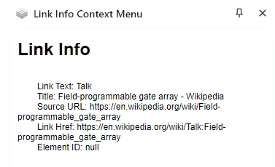
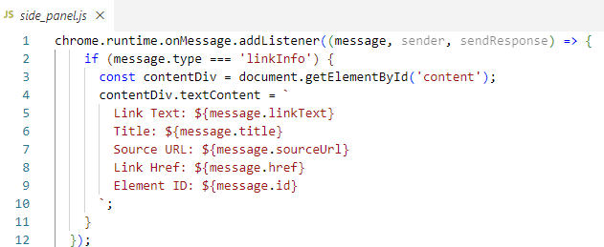
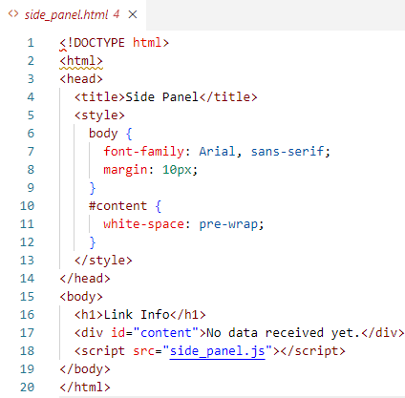
Implementation of the Link detail provIder
8
and other code snippets
9

Slide 29
Link details retrieved and presented
2
5
3
1
4
8
9
6
7

Slide 30
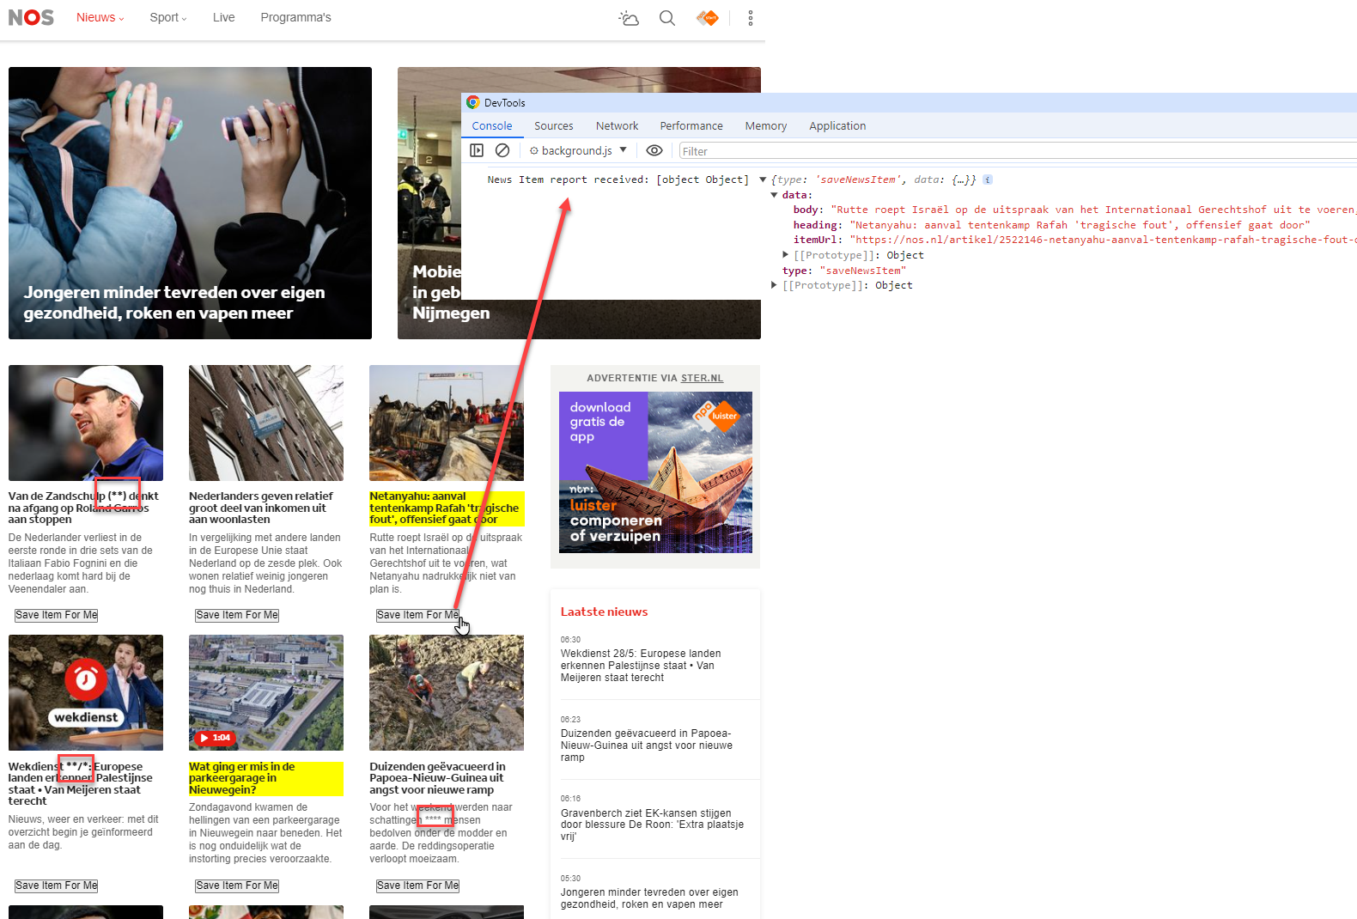

Slide 31
nos.nl extension
Hide numbers
Highlight items with specific keywords
Add buttons to save news items
Side Panel

Slide 32
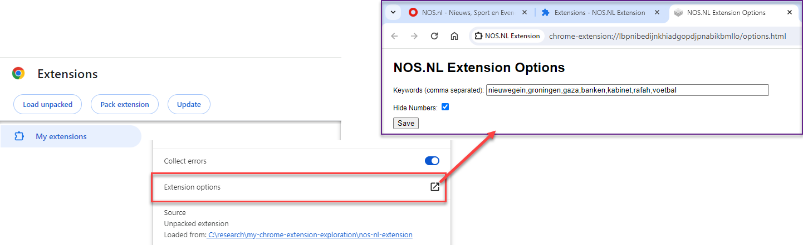
Extension Options

Slide 33
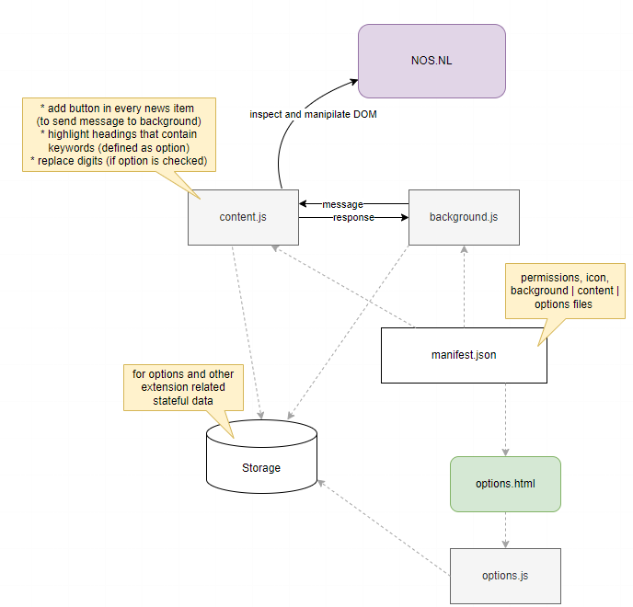
4
3
6
5
2
7
1

Slide 34
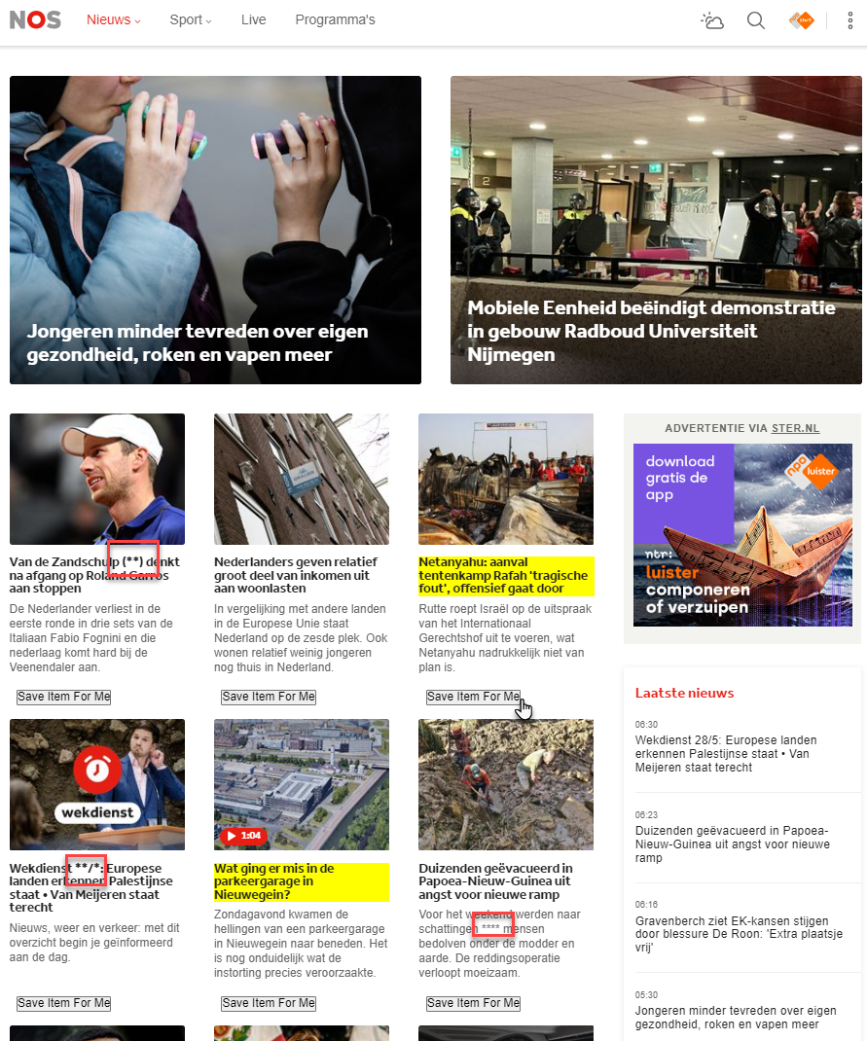
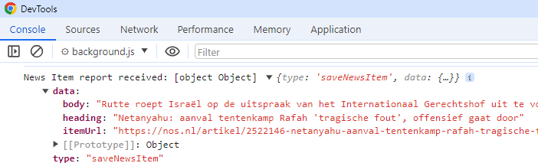
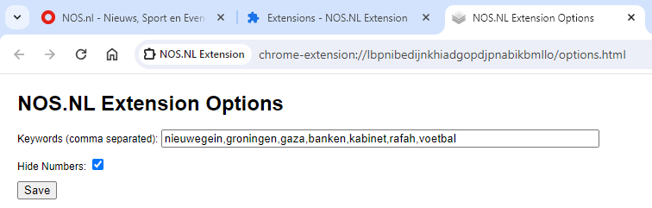
4
3
6
5
2
7
1

Slide 35
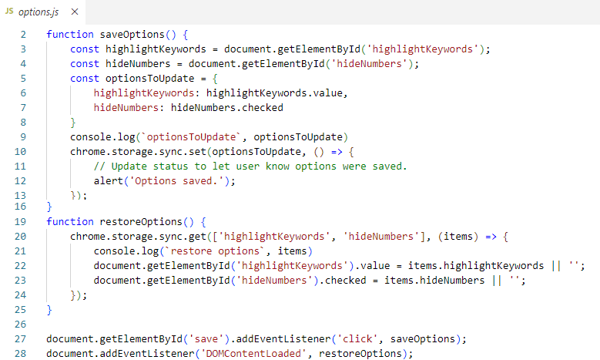
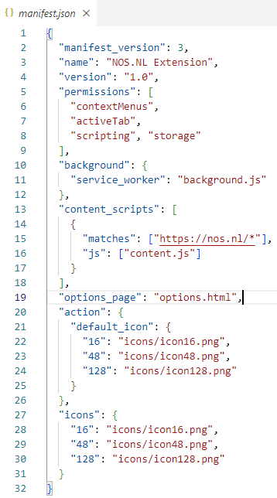
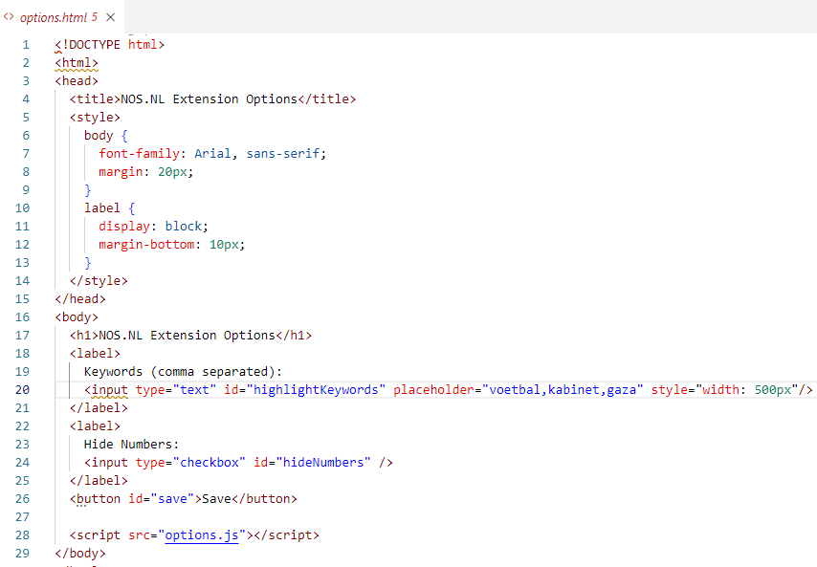
nos.nl decorator extension

Slide 36
nos.nl decorator extension
1

Slide 37
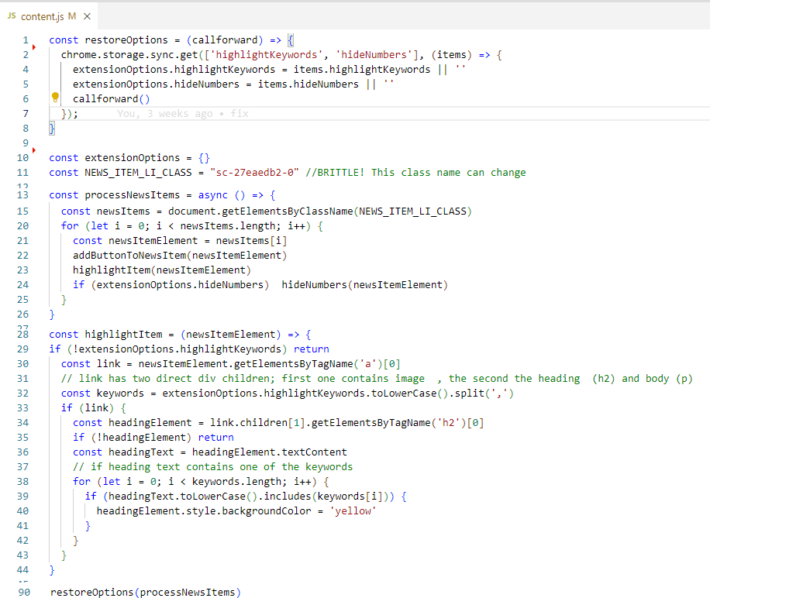
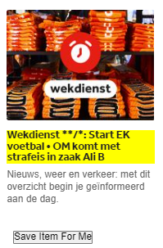
nos.nl decorator extension
2
3
4

Slide 38
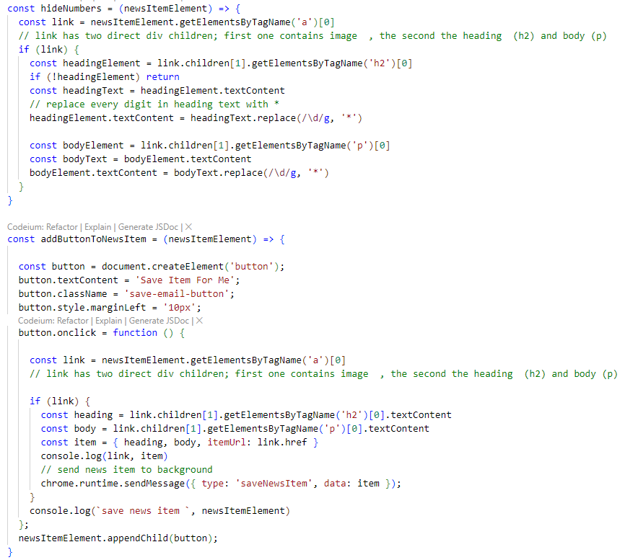
nos.nl decorator extension

Slide 39
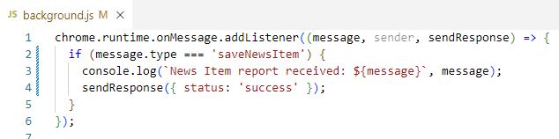
nos.nl decorator extension
5
6

Slide 40
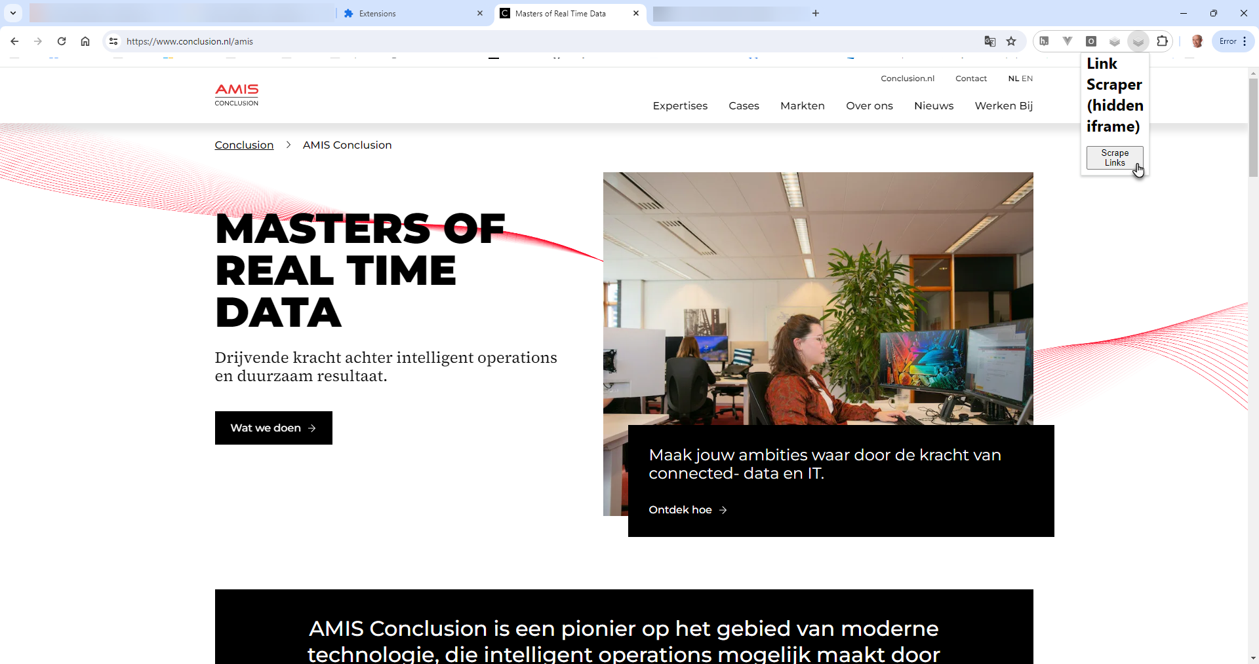
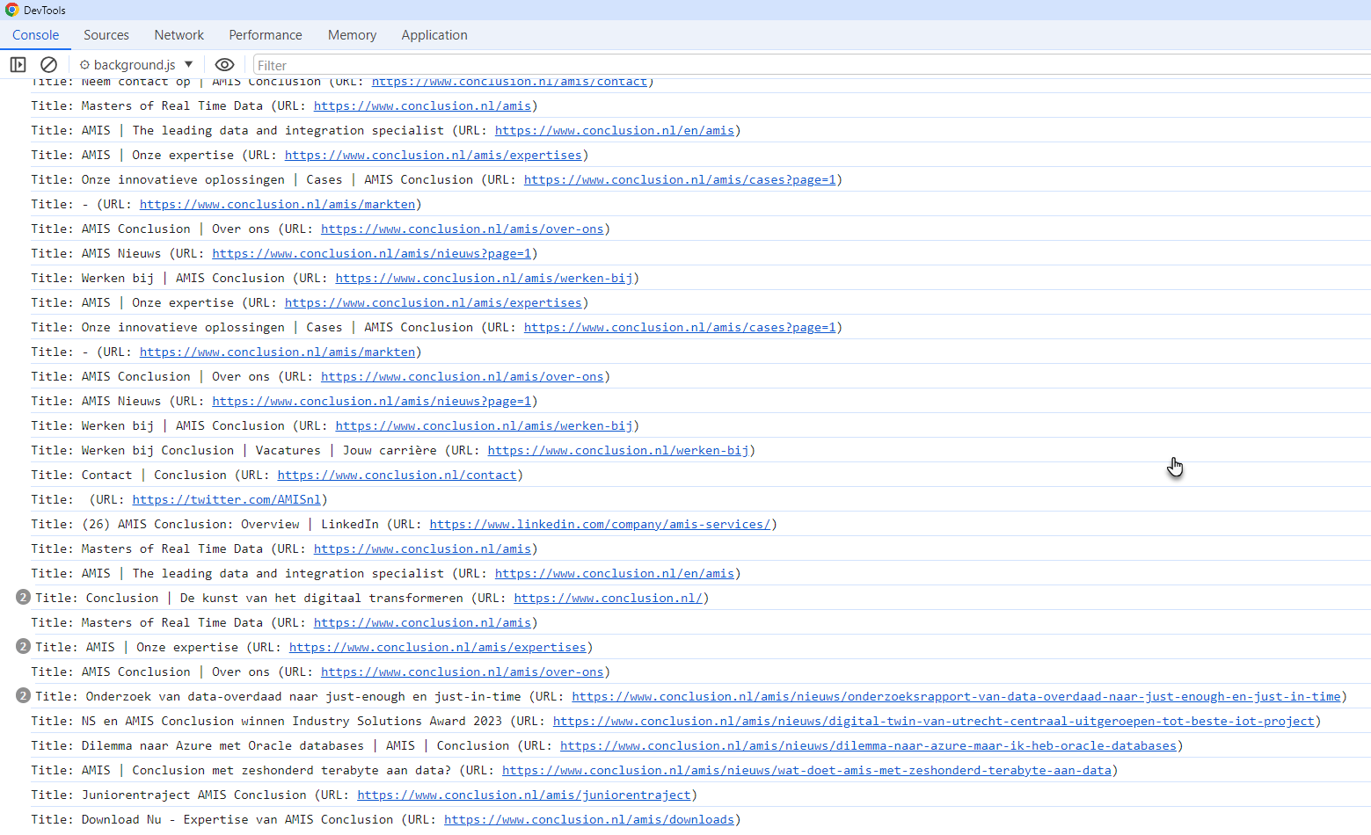
Crawler – list titles of all pages linked from the current one
Activate the extension for the current page – from the extension menu & popup
Find all links in the current page
Visit all pages referenced by these links and collect data from them
submit all gathered data to the background service work for processing

Slide 41
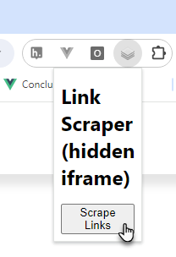
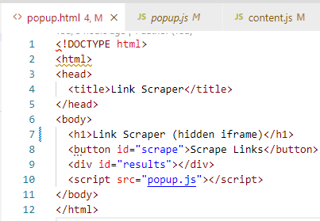
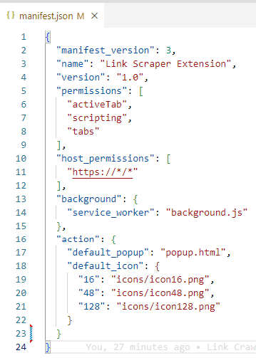
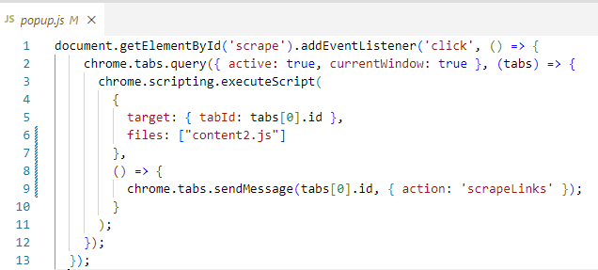
Popup – button launches crawl
1
2

Slide 42


Popup – sends message to content
4
3
2

Slide 43


Popup – content sends messages to background
4
5
3

Slide 44

Crawler (using IFRAME)
Press button (1)
Send message to content.js (2)
Get all links in the active document (3)
Add an IFRAME to the document (4)
for load all links (one by one) in that IFRAME
retrieve title from the IFRAME when the page has loaded
and send it in a message (to background service worker)
Write message to console (5)

Slide 45


alternative link crawler implementation: instead of an iframe – use a second tab
Main benefit: not all sites accept being loaded in an IFRAME – no such problem with a Tab
Drawback: the Tab is visible and the extension’s operation therefore is somewhat less smooth

Slide 46
alternative link crawler implementation: instead of an iframe – use a second tab

Slide 47



1
2

Slide 48


3
5
4

Slide 49
5
6
7

Slide 51
alternative link crawler implementation: instead of an iframe – use a second tab

Slide 52


Inspect sources of installed extensions
C:\Users\lucas_j\AppData\Local\Google\Chrome\User Data\Default\Extensions\olljocejdgeipcaompahmnfebhkfmnma

Slide 53
Inspect sources of installed extensions: locate in C:\Users\<user>\AppData\Local\Google\Chrome\User Data\Default\Extensions
C:\Users\lucas_j\AppData\Local\Google\Chrome\User Data\Default\Extensions\olljocejdgeipcaompahmnfebhkfmnma

Slide 54
Summary
Chrome Extensions are HTML, CSS and JavaScript applications
Constituents may include:
popup
options (aka settings aka user preferences)
side panel
background (service worker)
context menu
content (can access DOM but not JavaScript) + injected script + injected IFRAME
Asynchronous communication between various extension parts
Extensions can store and retrieve data in local storage
Extensions can easily be loaded from a file (easily be updated, monitored, disabled)
Note: any extension you have installed can easily be inspected
to verify it does nothing nasty and to use as inspiration for your own extensions

Slide 55
Logo
www.conclusion.nl

